Slide 1
Introduction To Internet Security
RSDY2S3G5
Group Members:
Boo Kai Jie
Ng Jhun Hou
Low Kim Hong
Liew Zi Li
Lim Jun Wei
Ong Yi Xin
Chia Ming Yi

Slide 2
Task 1

Slide 3
Introduction
Cryptography | Securing information and communications through the use of codes Use math algorithm and keys for data conversion
Importance | Minimize personal data exposure Ensure data integrity & maximize data trustworthiness Ensure accountability by preventing from action denying
Application | Secure Communication Protocols Secure Data Storage E-commerce and Financial Transactions Secure Emails

Slide 4
Fundamentals of Cryptography
Computer science technique to ensure security
Key Concepts | Encryption (Plain text -> Ciphertext) Symmetric Asymmetric Decryption (Ciphertext -> Plain text)
Goals | Confidentiality (authorized parties) Authentication (genuine and trustworthy Integrity (data unchanged))

Slide 5
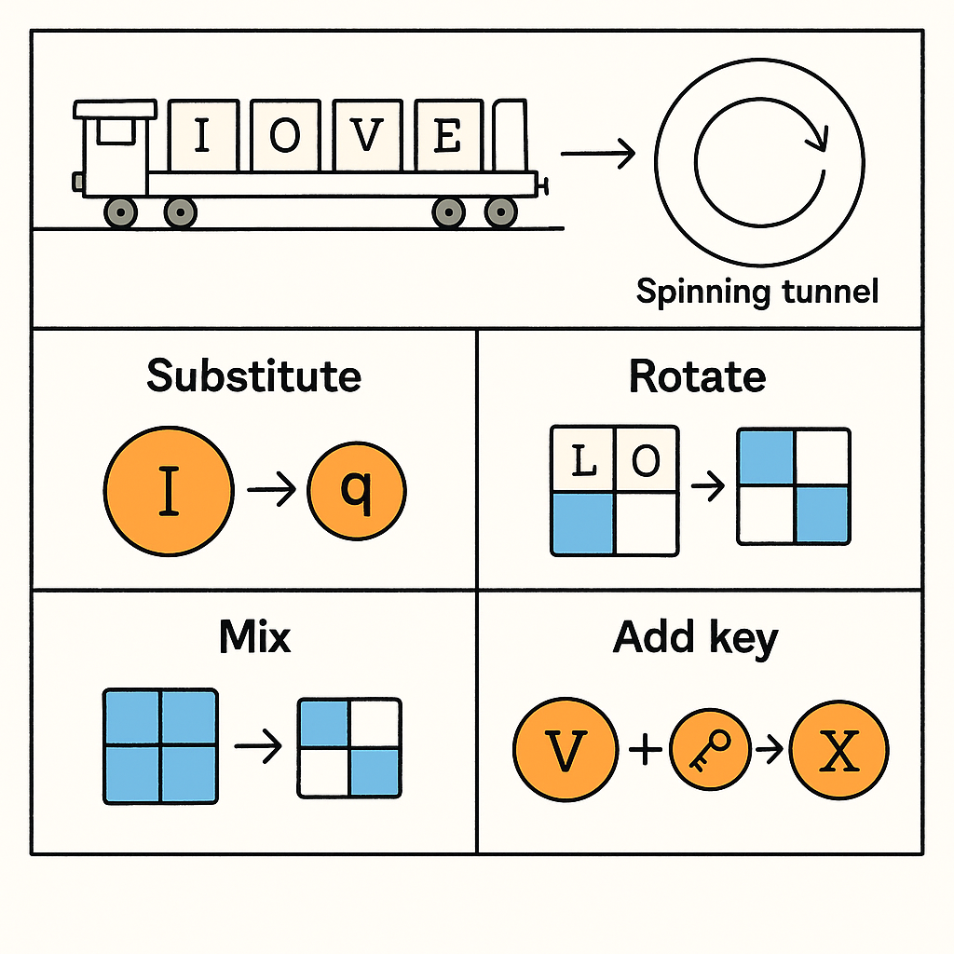

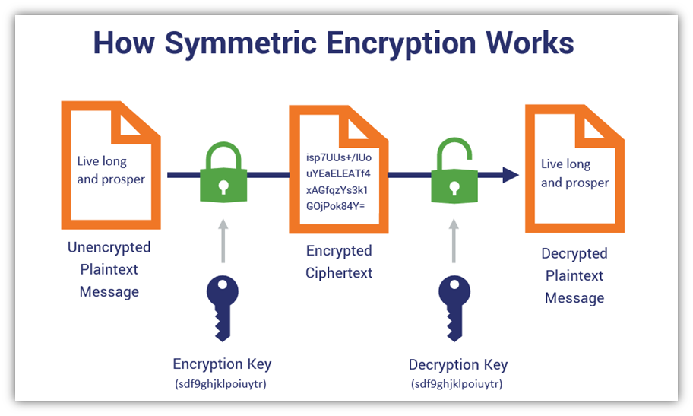
Cryptography Types - Symmetric
Single key for both encrypt & decrypt
Algorithm - AES | Advanced Encryption Standard Symmetric block cipher Fixed-size blocks (128 bits) SubBytes, ShiftRow, MixColumns, AddRoundKey Key size ? -> repeat steps
Algorithm - ChaCha20 | Stream cipher Pseudo-random keystream 256-bit key, 23-bit counter, 96-bit nonce 4x4 matrix of 32-bit words

Slide 6
Cryptography Types - Symmetric
Strength | Efficiency and speed Large amount of data Minimal computational overhead Simple to implement
Weakness | Key distribution (hard securely share) Lacks scalability (require unique) Easily tempered (X built-in authentication)
Compare | Asymmetric encryption Secure, Low speed, Complex to implement
Use Cases | Banking Industry Payment Application (Credit Card) Process large amount data daily Used for data at rest (Database - sensitive data)

Slide 7
Cryptography Types - Asymmetric
Pair of keys (public key & private key) for encryption & decryption
Key Characteristics | Preparation of key pair Unique key pairs from sender and receiver No redundant keys used between sender and receiver Elimination of secure key exchange Lower performance compared to symmetric cryptography
Algorithms | RSA (Rivest-Shamir-Adleman) Diffie-Hellman Key Exchange Elliptic Curve Cryptographic (ECC) Digital Signature Algorithm (DSA)

Slide 8
Cryptography Types - Asymmetric
Strengths | Implementation of Public and Private Key Message Authentication Non-Repudiation
Weaknesses | Slow Performance Lack of Public Key Authentication Key Management Challenges
Compare | Asymmetric Cryptography vs Symmetric Cryptography Number of keys used Performance Security Asymmetric Cryptography vs Hash Functions Objectives Security basis Reversibility

Slide 9
Cryptography Types - Asymmetric
Use Cases | Digital Signatures Key Exchange Cryptocurrency

Slide 10
Cryptography Types - Hash Function
Chia Ming Yi
Definition: Hash functions are essential tools in cryptography for ensuring data integrity and security.
Purpose: They map input data to a fixed-length output, enabling efficient and secure data processing.
Key Characteristics of Hash Functions
Deterministic: Always produce the same output for the same input.
Efficiency: Fast computation irrespective of input size.
Fixed Output Size: Ensures uniformity, regardless of the input length.
Security Features:
Pre-image resistance: Difficult to determine the original input.
Second pre-image resistance: Hard to find another input producing the same hash.
Collision resistance: Prevents two different inputs from producing the same hash.
Avalanche effect: Small input change leads to a significantly different hash.

Slide 11
Cryptography Types - Hash Function
Chia Ming Yi
Algorithms
MD5: Previously widely used, now insecure due to collision vulnerabilities.
SHA-1: Known weaknesses, no longer recommended.
SHA-2: Includes SHA-256, SHA-384, and SHA-512. SHA-256 is widely used, especially in blockchain technology.
SHA-3: Designed for enhanced security and resistance to modern cryptographic attacks.
Strengths
Data Integrity: Detects tampering by verifying hash consistency.
Efficiency: Fast processing of large data sets, making them ideal for authentication and digital forensics.
Versatility: Widely used in password protection, MACs, blockchain, and more.
Weaknesses
Non-reversibility: Once hashed, data cannot be retrieved (password recovery limitations).
Collision Vulnerabilities: MD5 and SHA-1 are susceptible to attacks, reducing security.
Quantum Computing Threat: Future quantum computers may break current hash functions, prompting the need for quantum-resistant algorithms.

Slide 12
Cryptography Types - Hash Function
Chia Ming Yi
Comparison with Other Cryptographic Techniques
Symmetric Encryption: Uses a single key for encryption and decryption.
Asymmetric Encryption: Uses public-private key pairs, slower but more secure.
Hash Functions: One-way functions with a fixed output size, ideal for data integrity and authentication.
Use Cases…
Digital Signatures
Password Storage and Authentication
Blockchain and Cryptocurrencies
File Integrity Verification
SSL/TLS Secure Communication

Slide 13
Cryptography Types - Hash Function
Chia Ming Yi
Use Cases…
Digital Signatures:
Purpose: Ensure the authenticity and integrity of messages/documents.
How it Works: A hash of the message is signed with the sender's private key. The recipient verifies the signature by comparing the decrypted hash with the freshly computed hash of the received message.
Applications: Legal contracts, secure email (PGP, S/MIME), software distribution.
Password Storage and Authentication:
Purpose: Protect user credentials from being exposed, even if databases are compromised.
How it Works: Passwords are hashed before storage. On login, the input password is hashed and compared to the stored hash.
Enhancements: Salted hashes make it more secure against precomputed attacks.
Applications: Online platforms, operating systems, and authentication services.

Slide 14
Cryptography Types - Hash Function
Chia Ming Yi
Blockchain and Cryptocurrencies:
Purpose: Ensure the security and integrity of decentralized ledgers.
How it Works: Hash functions link blocks in a blockchain, forming a secure and immutable chain. Any modification to a block alters its hash, making tampering evident.
Applications: Bitcoin (SHA-256), Ethereum (Keccak-256), and other blockchain technologies.
File Integrity Verification:
Purpose: Verify the authenticity of files during transmission or storage.
How it Works: A hash is generated for a file and shared by the provider. The user checks if the downloaded file's hash matches the provided hash to confirm it's unaltered.
Applications: Software downloads, cloud storage, and forensic investigations.
SSL/TLS Secure Communication:
Purpose: Ensure secure communication over the internet.
How it Works: Hash functions are used in Message Authentication Codes (MACs) to ensure data integrity in SSL/TLS protocols.
Applications: HTTPS encryption, online banking, e-commerce transactions, and private communications.

Slide 15
Major Cryptographic Protocols
Chia Ming Yi
Essential for securing digital communications
Ensure confidentiality, integrity, and authentication
Two main types: Symmetric & Asymmetric
Hybrid Cryptographic Protocols
Combining symmetric & asymmetric cryptography for better security
TLS (Transport Layer Security) Protocol
Uses RSA for key exchange & AES for encryption
Protects online transactions (banking, e-commerce, government websites)
Tokenization & HMAC (Hash-based Message Authentication Code)
Used in financial transactions for fraud prevention
Cryptographic Protocols in Blockchain & Digital Security
Elliptic-Curve Cryptography (ECC)
Secure authentication & digital signatures
Cryptographic Hash Functions (SHA-256, Keccak-256)
Data integrity & protection against tampering
Blockchain security (Bitcoin, Ethereum, IBM Food Trust)
Symmetric
Uses a single key for encryption & decryption
Advanced Encryption Standard (AES)
Secures web traffic (HTTPS)
Protects files (VeraCrypt, BitLocker)
Enables end-to-end encryption (WhatsApp, Signal)
Used in VPNs for secure data transmission
Asymmetric
Uses a public key for encryption & private key for decryption
Rivest-Shamir-Adleman (RSA)
Secures web connections (SSL/TLS)
Used in secure emails (PGP, S/MIME)
Enables digital signatures for document integrity

Slide 16
Challenges
Chia Ming Yi
Quantum Computing Threats
Quantum computers can break RSA & ECC encryption
Sensitive data (financial, medical, government) at risk
Research into quantum-resistant algorithms (lattice-based, code-based, hash-based)
Practical implementation of post-quantum cryptography remains challenging
Key Management Issues
Poor generation, distribution, and storage of cryptographic keys
Weak key management leads to unauthorized access & data breaches
Solutions: Hardware Security Modules (HSMs), strong key rotation, multi-factor authentication
Cloud computing & distributed systems pose additional risks
Regulatory Compliance Challenges
Data protection laws require encryption for security
Governments advocate for encryption backdoors for security investigations
Risk: Backdoors may introduce vulnerabilities
Ongoing debate between privacy, security, and law enforcement needs

Slide 17
Future Trends
Chia Ming Yi
Post-Quantum Cryptography (PQC)
Designed to resist quantum-based attacks
NIST standardization process evaluating secure algorithms
Hybrid approaches: Combining classical and quantum-resistant cryptography
Homomorphic Encryption
Enables computation on encrypted data without decryption
Enhances data privacy in cloud computing
Still in early development but expected to play a key role in future security
Quantum Key Distribution (QKD)
Uses quantum mechanics for secure key exchange
Theoretically unbreakable encryption (interception alters the key)
Challenges: High costs & infrastructural limitations
Bring Your Own Encryption (BYOE)
Organizations use their own encryption & key management
Reduces reliance on third-party cloud providers
Ensures greater control over sensitive data
Automation & PKI Management
Increasing need for automated certificate revocation & renewal
Addresses shorter certificate lifespans & quantum security threats
Expected to enhance security & efficiency in cryptographic systems

Slide 18
Task 2

Slide 19
Task 2 : Part A
Background of Blockchain in Cybersecurity
Importance of Blockchain in Cybersecurity

Slide 20
Background
Introduction to Blockchain in Cybersecurity
Decentralized & Distributed Ledger:
Unlike traditional centralized systems, blockchain stores data across multiple nodes, reducing the risk of a single point of failure.
Immutability & Transparency:
Once a record is added, it cannot be altered without consensus, preventing tampering and ensuring trust.
Cryptographic Security:
Advanced encryption methods protect data, ensuring only authorized users can access sensitive information.

Slide 21
Why Blockchain is Essential for Cybersecurity
Importance of Blockchain in Cybersecurity
🔹 1. Data Integrity & Tamper Resistance
Cryptographic linking ensures data remains unaltered.
Any tampering is instantly detected, protecting sensitive information.
🔹 2. Decentralization: Eliminating Single Points of Failure
Unlike centralized systems, blockchain spreads data across multiple nodes.
Even if some nodes are attacked, the network remains secure.
🔹 3. Strong Encryption & Privacy
Advanced encryption protects transactions and sensitive data.
Balances transparency with privacy, ensuring secure access control.

Slide 22
Why Blockchain is Essential for Cybersecurity
Importance of Blockchain in Cybersecurity
🔹 4. Fraud Prevention & Authentication
Secure identity management reduces identity theft and fraud.
Multi-signature authentication adds extra layers of security.
🔹 5. Defense Against Cyber Threats
Real-time monitoring detects and prevents cyberattacks.
Mitigates risks like DDoS attacks and unauthorized access attempts.

Slide 23
Task 2 : Part B
The components and technology involved
The current challenges and emerging solutions
Process Involved
Threats and example of security related technologies usage

Slide 24
The components and technology involved
Core Components:
Blockchain Nodes
Store and validate transaction data.
Types of nodes:
Full Nodes: Maintain a complete copy of the blockchain.
Partial (Lightweight) Nodes: Store only hash values of transactions.
Mining Nodes: Validate transactions and add new blocks (PoW).
Distributed Ledger
Secure, immutable record of transactions.
Key elements of blocks: Transactions, timestamps, previous block references.
Types of ledgers:
Public Ledger: Open access to transactions.
Distributed Ledger: All nodes maintain a copy & verify transactions.
Decentralized Ledger: No central authority, ensures transparency.
Transactions in Blockchain
Represent transfer of value or data.
Verified by nodes to prevent fraud (e.g., double-spending).
Key components:
Sender & receiver addresses.
Transfer amount.
Digital signatures for authenticity.
Consensus Mechanisms
Ensure agreement on valid transactions.
Types of consensus algorithms:
Proof of Work (PoW): Miners solve complex puzzles (e.g., Bitcoin).
Proof of Stake (PoS): Validators chosen based on coin stake, energy-efficient.
Delegated Proof of Stake (DPoS): Users vote for trusted delegates, improves scalability.

Slide 25
The components and technology involved
Supporting Technologies:
Cryptographic Security
Hash Functions: Convert data into fixed-size hash values, ensuring tamper-proof security.
Digital Signatures: Authenticate transactions using public-private key pairs.
Public & Private Keys: Ensure only authorized access to transactions.
Smart Contracts
Self-executing contracts with predefined conditions.
Automate processes, removing intermediaries.
Use cases: DeFi, supply chain management, insurance claims.
Tokens in Blockchain
Utility Tokens: Provide access to services (e.g., Ethereum’s Ether).
Security Tokens: Represent real-world assets (stocks, real estate).
Stablecoins: Pegged to fiat currencies for price stability.

Slide 26



Lack of trust
High energy Consumption
Interoperability
Challenges and Solutions in Blockchain
Organizations are hesitant due to security concerns and regulatory uncertainty. Solutions include permissioned blockchains with verified participants.
Proof-of-Work (PoW) systems require vast computing power. Energy-efficient alternatives like Proof-of-Stake (PoS) are being developed.
Different blockchain networks use independent protocols. Solutions like Ark's SmartBridges and Cosmos' IBC enable cross-blockchain communication.

Slide 27

Process Involved in Blockchain
Transaction Validation
Distributed Database
Transactions are sent to a memory pool, compiled into a block, and validated by miners.
Multiple copies of data are stored across different machines, ensuring consistency and security
Block Addition
Once validated, the block is added to the blockchain, and transactions are confirmed after multiple additional blocks are added.

Slide 28
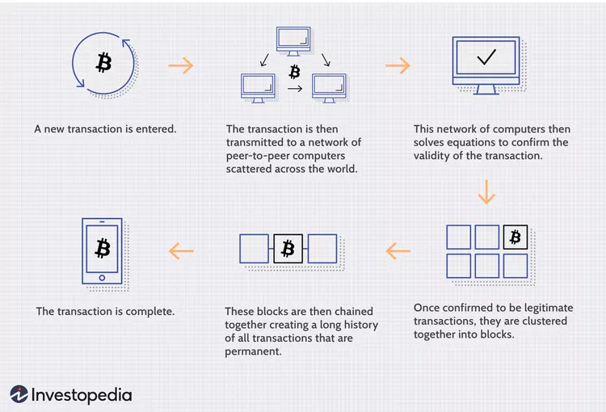

Slide 29
Threats and Security Applications of Blockchain
Cyber Threats
1. Phishing Attacks
Attackers use fake emails/websites to steal private keys or login credentials.
Can lead to wallet breaches and unauthorized fund transfers.
2. Routing Attacks
Hackers intercept data between blockchain nodes or ISPs.
Allows data extraction or delayed transactions while appearing normal.
3. Sybil Attacks
Attackers create multiple fake identities (nodes) to gain control.
Can manipulate voting, disrupt operations, or slow down network performance.
4. 51% Attacks
A single entity controls more than 50% of the network’s computational power.
Enables rewriting of transaction history, double-spending, and transaction blocking.
More common in public blockchains; private blockchains are less vulnerable.

Slide 30
Threats and Security Applications of Blockchain
Examples of Blockchain Security Usage
1. Financial Services
Ensures secure, immutable, and transparent transactions.
Reduces fraud risks, double-spending, and unauthorized changes.
Enhances transaction efficiency and trust in banks & financial institutions.
2. Healthcare Industry
Secures patient records with encryption and decentralized storage.
Prevents unauthorized access and enhances data sharing among providers.
Maintains data integrity and supports secure medical research collaboration.
3. Supply Chain Management
Provides a tamper-proof record of product movement.
Verifies product authenticity and combats counterfeiting.

Slide 31
Task 2 : Part C
The Impact of Blockchain in Cybersecurity

Slide 32
✅ Benefits of Blockchain in Cybersecurity ✅
Enhanced Data Security and Integrity
Immutable ledger prevents data tampering.
Reduces risks of data breaches and unauthorized modifications.
Crucial for healthcare, finance, and government sectors.
3. Improved Authentication and Identity Management
Secure identity verification using cryptographic authentication.
Reduces identity theft and fraud.
Self-sovereign identities give users control over personal data.
2. Decentralization Reducing Single Points of Failure
Traditional centralized systems are vulnerable to cyberattacks.
Blockchain distributes data across multiple nodes.
Enhances resilience against DDoS attacks and ransomware.
4. Transparency and Trust
Transactions are traceable and verifiable.
Useful for supply chains, financial transactions, and regulatory compliance.

Slide 33
⚠ Limitations of Blockchain in Cybersecurity ⚠
Scalability Issues
Proof of Work (PoW) systems require high computational power.
Slow transaction processing and high energy consumption.
Solutions: Layer 2 (sidechains, sharding).
2. Regulatory and Compliance Challenges
Global decentralization conflicts with data protection laws.
Issues with compliance (e.g., GDPR).
3. Energy Consumption
PoW-based systems consume excessive energy (e.g., Bitcoin mining).
Need for eco-friendly alternatives (PoS, hybrid models).

Slide 34
🚀 Future Potentials of Blockchain in Cybersecurity 🚀
2. Quantum-Resistant Cryptography
Quantum computing threatens traditional encryption.
Research on post-quantum cryptography (e.g., lattice-based encryption).
Integration with AI and IoT
AI-driven blockchain security detects cyber threats.
Blockchain secures IoT devices from attacks.
3. Adoption in Government and Public Services
Securing digital identities, voting systems, and public records.
Enhances transparency, efficiency, and trust in governance.

Slide 35
Task 2 : Part D
Effective of current energy-efficient consensus algorithms

Slide 36
Effectiveness of Current Energy-Efficient Consensus Algorithms
Proof-of-Stake (PoS) & Delegated Proof-of-Stake (DPoS)
PoS: Replaces mining with staking, cutting energy use by 99% (e.g., Ethereum).
DPoS: Uses elected validators for efficiency (e.g., EOS, Tron).
Challenge: Risk of centralization due to control by a few entities.
Proof-of-Authority (PoA)
No mining, only pre-approved validators.
Very low energy consumption (like a traditional database).
Used in private networks (e.g., Fnality).
Challenge: Limited decentralization, unsuitable for public blockchains.
3. Practical Byzantine Fault Tolerance (PBFT) & Variants
S-PBFT: 30-40% lower energy consumption than PBFT.
Great for financial & consortium blockchains.
Challenge: Scalability issues in large networks.
4. Hybrid & Niche Consensus Mechanisms
Green-PoW: Uses renewable energy & adjusts difficulty dynamically.
Raft & FBA: Efficient for private networks.
Challenge: Infrastructure limitations for renewable energy adoption.

Slide 37
Key Challenges
Scalability vs. Efficiency Trade-offs
PoS & DPoS reduce energy but still face transaction throughput issues.
Hardware Limitations
Even efficient algorithms require high-performance hardware, creating barriers.
3. Centralization Risks
DPoS & PoA improve efficiency but reduce decentralization.
4. Renewable Energy Integration Challenges
Lack of blockchain infrastructure to fully utilize solar/wind energy.

Slide 38
Proposed Improvements
Adaptive Hybrid Consensus Models
Combine PoS & PBFT with sharding to improve scalability & efficiency.
Decentralized Renewable Energy Integration
Use token rewards & carbon credits for green mining.
Develop "green nodes" powered by solar/wind energy.
3. Research Quantum-Resistant Algorithms
Prepare for quantum computing threats while maintaining energy efficiency.
4. Hardware-Software Co-Design
Optimize ASICs for low-power consensus.
Use lightweight clients & data compression to lower processing demands.
5. Governance & Standardization
Set interoperability standards for energy-efficient blockchains.
Improve DPoS governance to prevent centralization.
6. Sector-Specific Customization
Optimize consensus mechanisms for industries like finance & supply chains.

Slide 39
End
Thank You

